Slide 1



Thinking Beyond LOS
(and Beyond the Peak)
for Transportation Analysis
Bastian Schroeder
Kittelson and Associates
KYTC Partnering Conference | September 2026

Slide 2



What is Level of Service (LOS)?
“LOS is a quantitative stratification of a performance measure or measures representing quality of service. ... The HCM defines six levels of service, ranging from A to F.”
“… Practitioners and decision makers alike must understand that the LOS letter result hides much of the complexity of facility performance.“
“Neither LOS nor any other single performance measure tells the full story of roadway performance. Depending on the particulars of a given analysis, queue lengths, demand-to-capacity ratios, average travel speeds, indicators of safety, quantities of persons and vehicles served, and other performance measures may be just as or even more important to consider, whether or not they are specifically called out in an agency standard. For this reason, the HCM provides methods for estimating a variety of useful roadway operations performance measures, not just methods for determining LOS.”
All quotes from HCM 7th Edition – Chapter 5: Quality of Service.

Slide 3
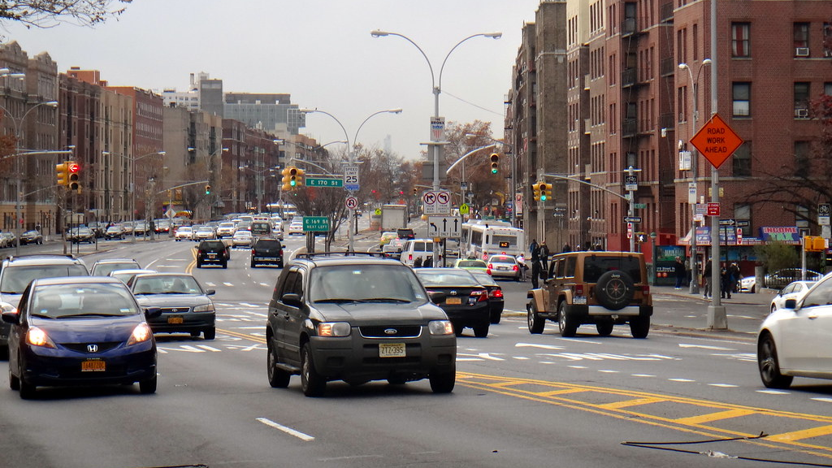

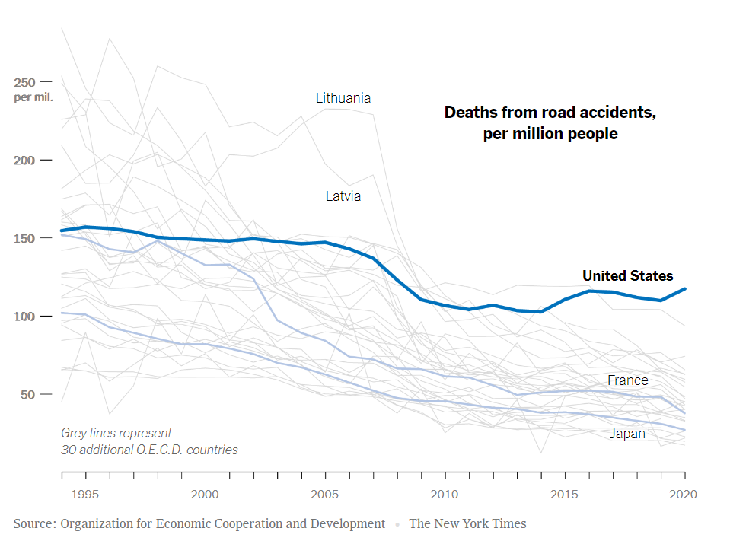
Notes:
Why is it important to daylight decisions about safety? Nationwide increases in fatal and severe injury crashes.

Slide 4
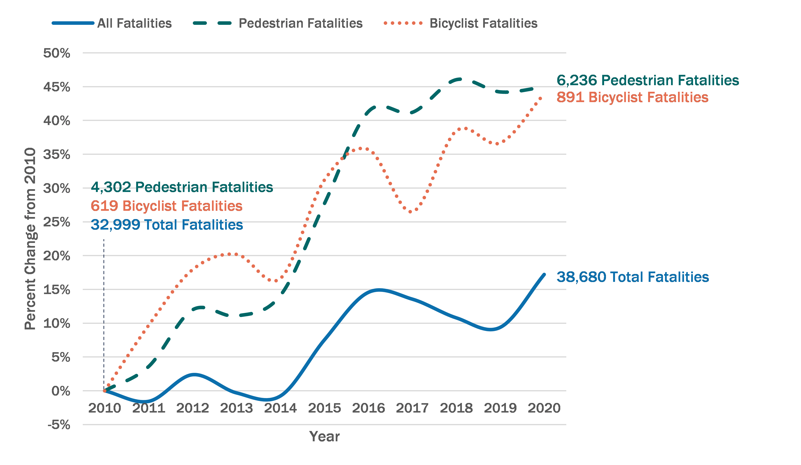
Fatalities of pedestrians and bicyclists have been increasing even greater
Source: US DOT
Notes:
We have a National Roadway Safety Problem – and it is getting worse… Especially for people walking and biking

Slide 5

We know what safe streets look like;
but how do we get there?
Notes:
The way we design our streets influences how much physical activity we get in our daily lives, which influences our health and wellbeing. People who live in walkable communities have lower incidence of heart disease, cardiovascular disease, and obesity.

Slide 6
FHWA is leading the shift – to the safe system approach
The Safe System Approach aims to eliminate fatal and serious injuries for all road users by:
Accommodating human mistakes
Keeping impacts on the human body at tolerable levels
Moving towards a Traffic Safety Culture
Notes:
The feds say so too

Slide 7
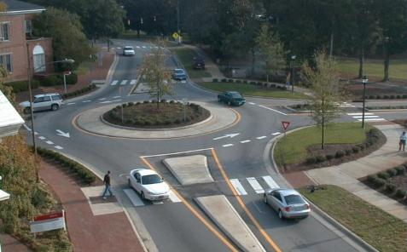

Slide 8
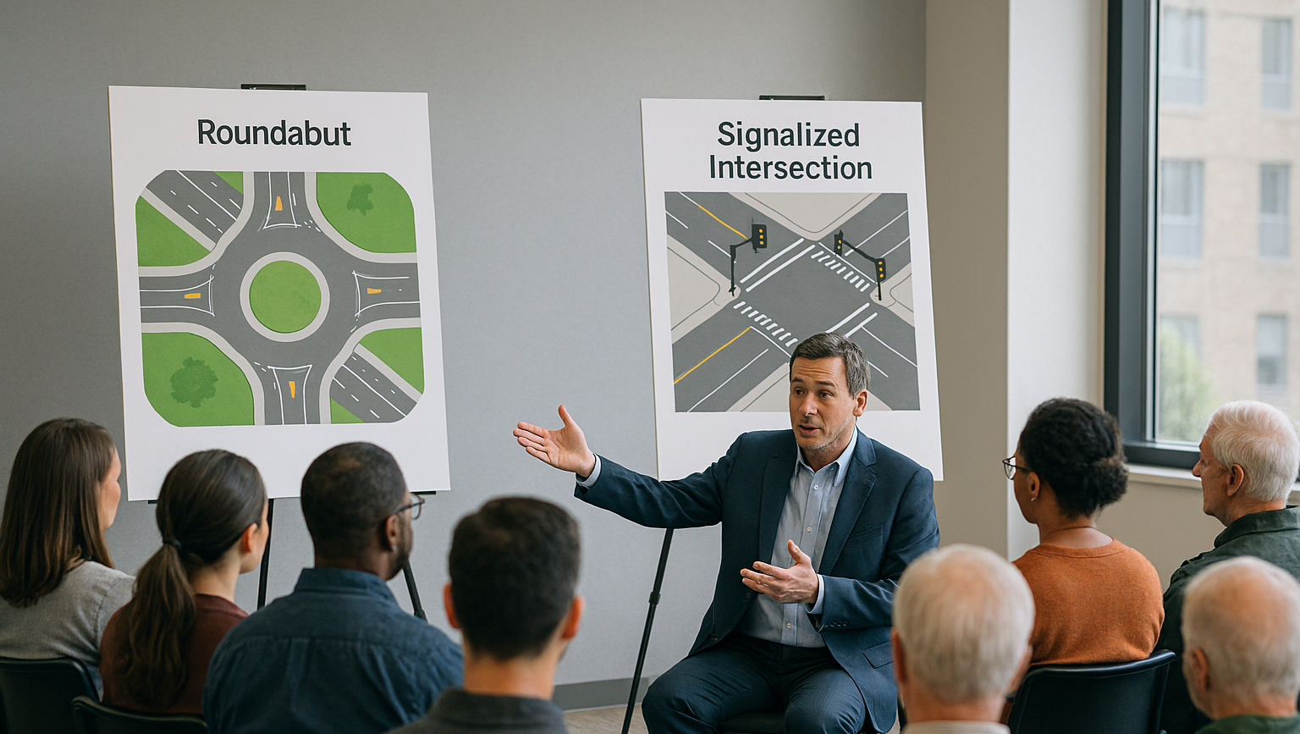
Roundabout
F
D

Slide 9

DAYLIGHT DECISION-MAKING
Notes:
This guide is fundamentally about decision-making, and communicating about the processes and tradeoffs that inform our decisions.
In an ideal world, the transportation decisions that we make are tied to a clear, objective process.
In the real world, many of our projects that involve robust, data-driven analyses result in murky outcomes.
We often end up with this disconnect because decision-making is difficult. Anyone who interacts with our projects, from the public to elected officials, has different experiences, priorities, and opinions about those projects. And our decision-makers are tasked with weighing ALL of these perspectives, along with the data, to come to a decision.

Slide 10
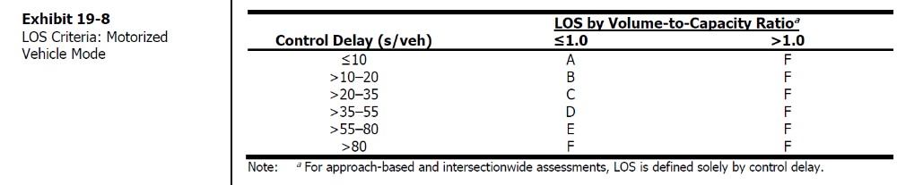
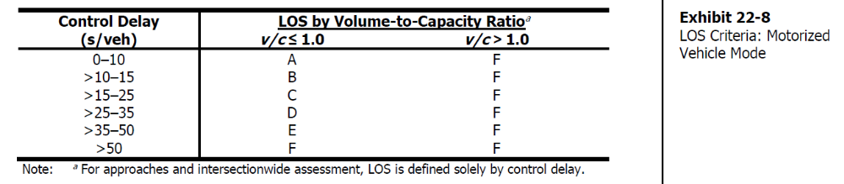
LOS For Signals vs. Roundabouts
Source: HCM 7th Edition, Chapters 19 and 22

Slide 11
d = 51 sec
d = 54 sec
Roundabout
F
D

Slide 12
What do we mean by Level of Service (LOS) F?
Based on a traffic forecast that predicts traffic 20 years into the future, we estimate that a driver entering the roundabout will be delayed by over 55 seconds during the peak 15 minutes of the 30th highest hour of the year.
… or mathematically:
(30*0.25) / (365*24*20) *100% = 0.043% of the next 20 years!
… and also:
There has never been a human factors or driver perception study to link experienced delay at roundabouts to LOS thresholds!

Slide 13
“THAT WON’T WORK.”
Notes:
We’ve already talked about:
-transparency
-raising the floor on safety
-articulating the benefits
Along those lines, we often encounter a tradeoff between safety and operational outcomes. You’ve almost certainly heard this phrase or said this phrase before: “That won’t work.” We agreed in developing the guide and methodology that it’s absolutely critical to unpack this – and to articulate what the implications of our decisions are.
<>
Despite the increasing availability of information about the diverse benefits of reallocating space in streets – we as planners and engineers still face a common argument when proposing reallocation projects.
<><><>
Based on this challenge - our team talked about a way to provide a broader perspective on operational impacts of road diets.

Slide 14
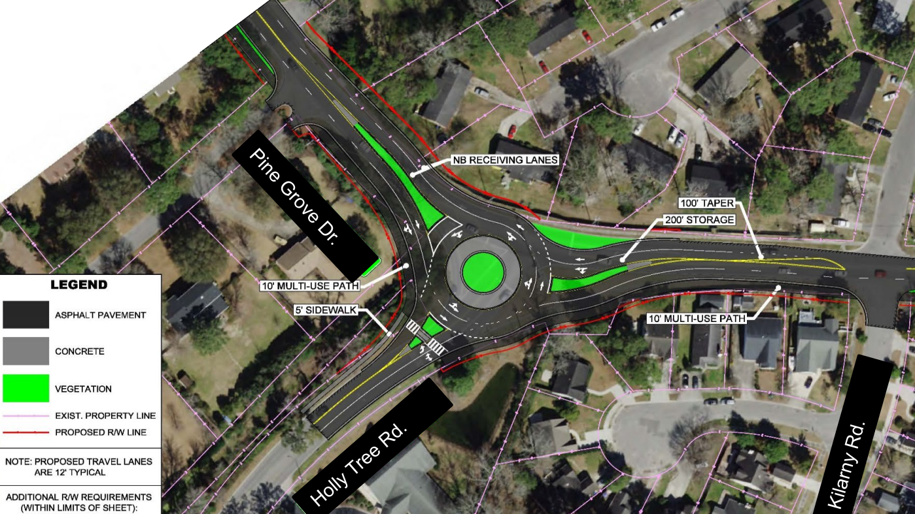
F

Slide 15
What is Capacity?
“The capacity of a system element is the maximum sustainable hourly flow rate at which persons or vehicles reasonably can be expected to traverse a point or a uniform section of a lane or roadway during a given time period under prevailing roadway, environmental, traffic, and control conditions.”
“Reasonable expectancy is the basis for defining capacity. That is, the stated capacity for a given system element is a flow rate that can be achieved repeatedly for peak periods of sufficient demand. Stated capacity values can be achieved on system elements with similar characteristics throughout North America. Capacity is not the absolute maximum flow rate observed on such a system element. The absolute maximum flow rate can vary from day to day and from location to location.”
All quotes from HCM 7th Edition – Chapter 4: Traffic Operations and Capacity Concepts

Slide 16
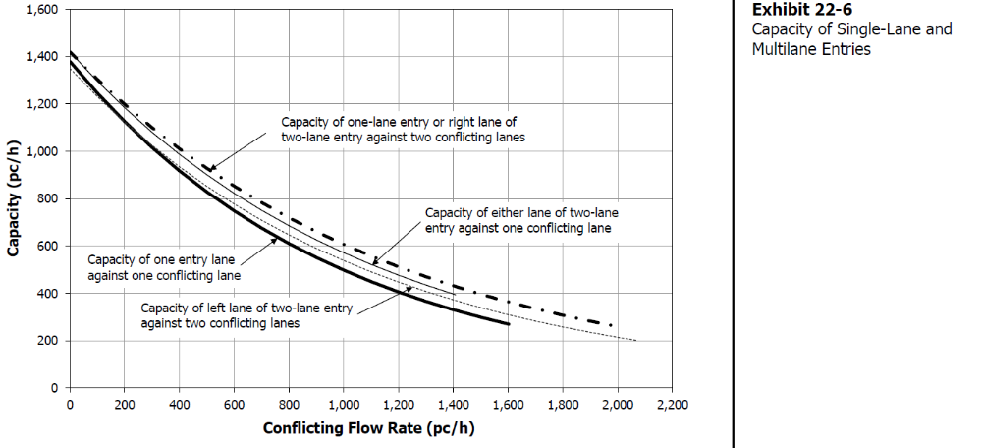
So What is the Capacity of a Roundabout?
Source: HCM 7th Edition – Chapter 22: Roundabouts

Slide 17
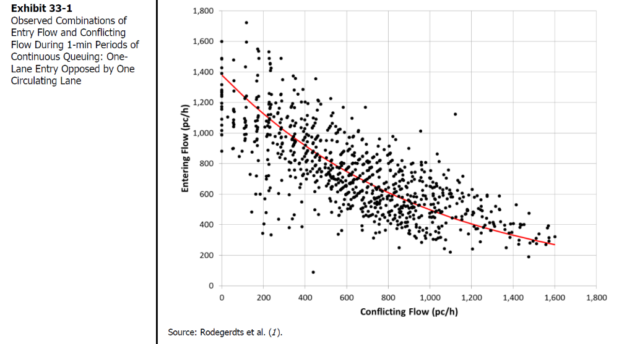
“… Capacity is not the absolute maximum flow rate observed on such a system element”
Source: HCM 7th Edition – Chapter 33: Roundabouts Supplemental

Slide 18
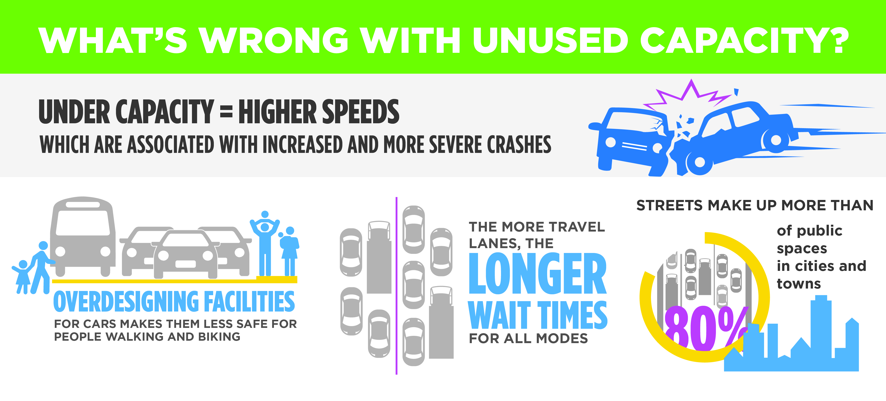
Notes:
Additional cost for construction and maintenance,
Increased exposure for pedestrians and bicyclists crossing at the intersection resulting in reduced comfort,
Lengthened clearance times for pedestrian phases that can result in longer cycle lengths and generally reduced efficiency of the intersection,
Increased crash frequency due to the introduction of additional conflict points,
Increase crash severity due to increases in vehicle speeds during off-peak periods,
Increased wait times for all users resulting from increased cycle length and less efficient signal phasing.

Slide 19
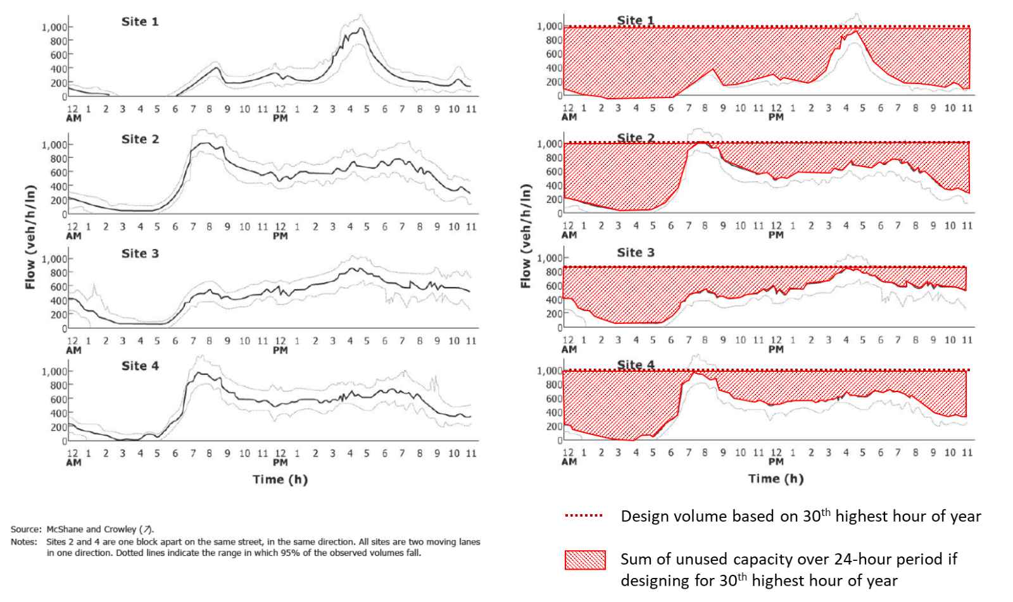
Designing for peak-hour capacity and the 30th highest hourly volume results in unused capacity for most
of the day!
Source: Adapted from HCM 7th Edition Chapter 3

Slide 20
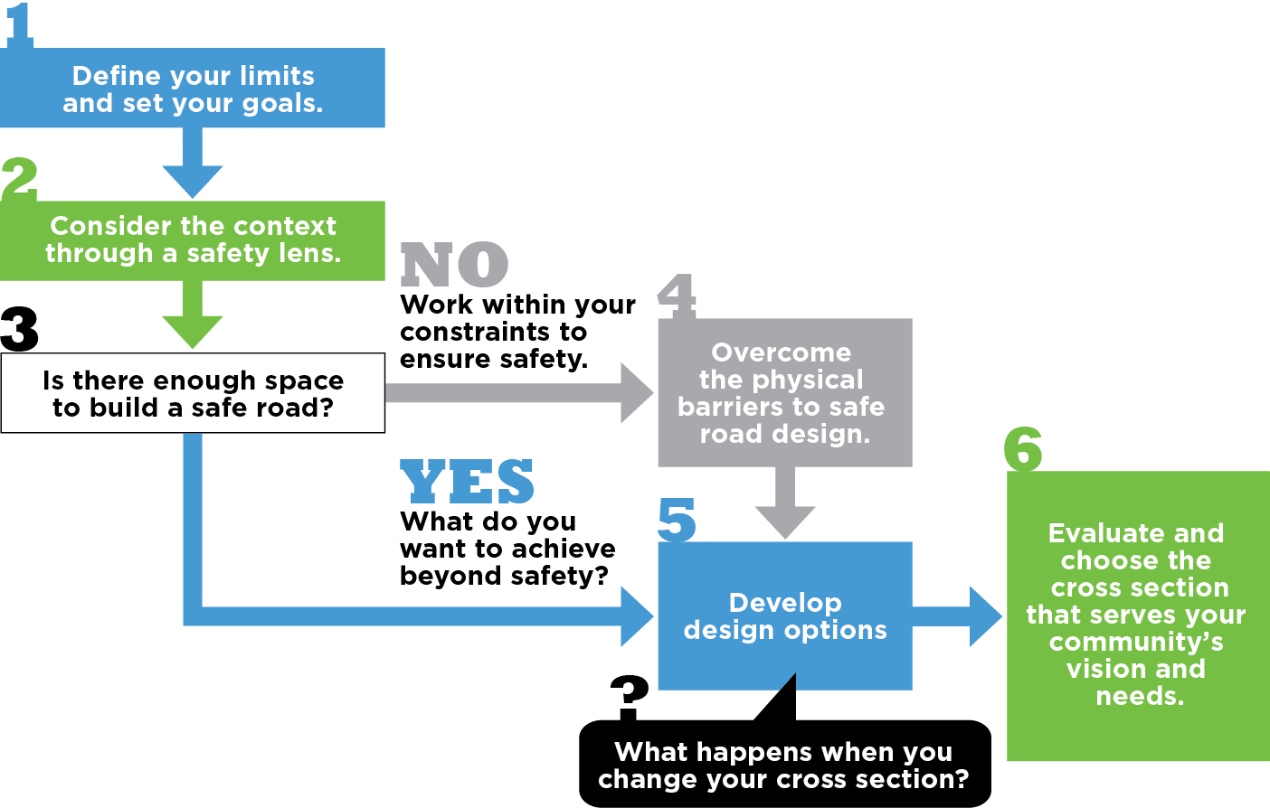
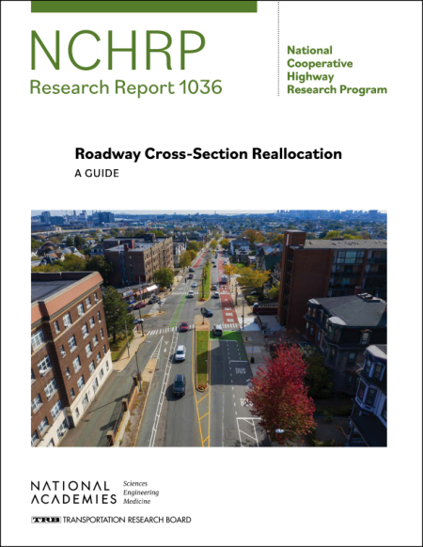
A NEW DECISION-MAKING FRAMEWORK
Notes:
Here it is – a clear process that prioritizes safety for all road users, presents solutions for achieving a safe design, and outlines the transpo and non transpo outcomes of your choices

Slide 21
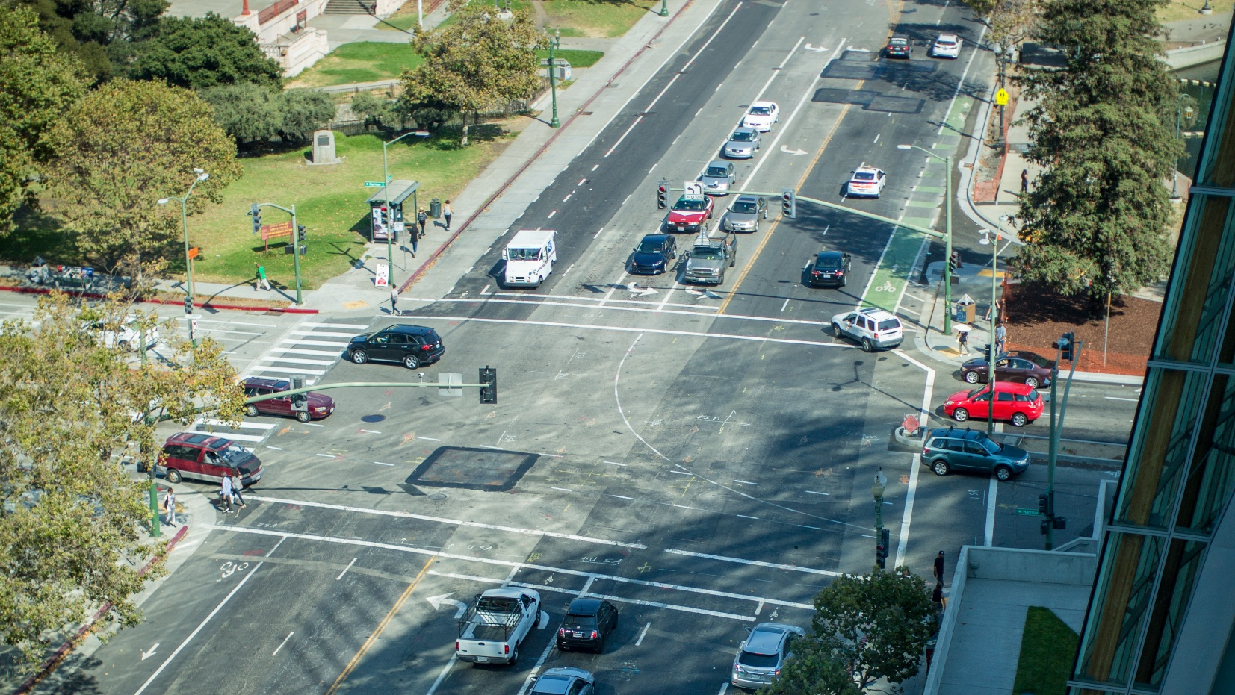

Slide 22
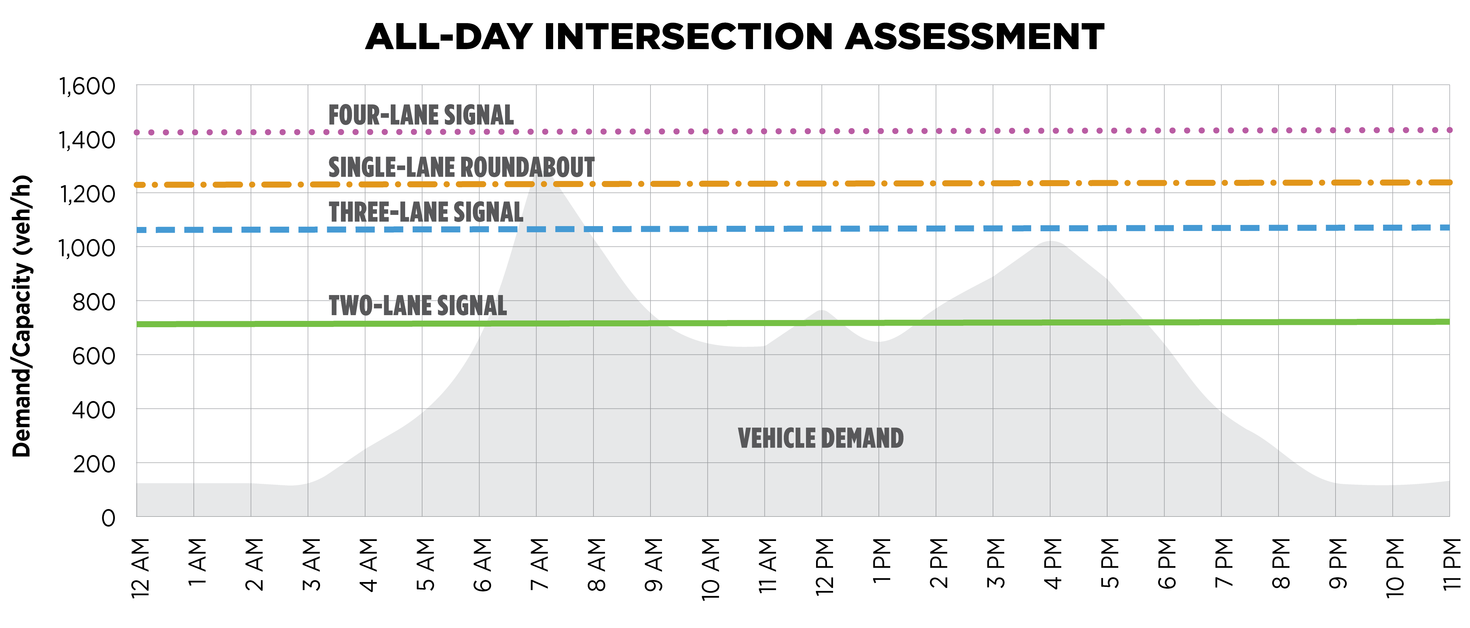
ALL-DAY INTERSECTION ASSESSMENT
Illustrative Example
Notes:
To that end, we wanted to broaden the perspective on what it means for the operations to “work” or not. Here you can see a time series throughout the day and how the capacity of various facilities increases or decreases. Given morning, midday, and p.m. peaking of demand, a reasonable question to ask is not “will it work?” but instead “will capacity be sufficient for demand and if not, what is the duration and nature of the oversaturated periods?”
<>
The transportation profession has long relied on the concept of the “peak 15 minutes of the 30th highest hour of the year” to serve as the traffic volume input for capacity.
But it’s worth asking…what about the other 8,730 hours of the year?!

Slide 23
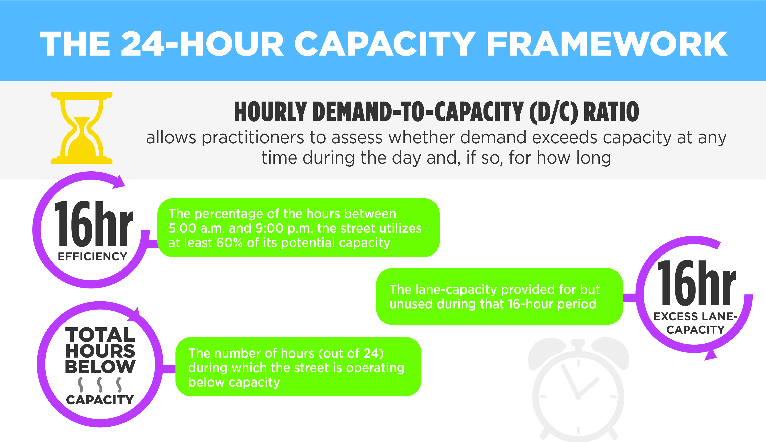
A NEW 24-HOUR PARADIGM
Notes:
Hourly demand-to-capacity (d/c) ratio
allows practitioners to assess whether demand exceeds capacity (d/c > 1) at any time during the day and, if so, for how long.
16-hour efficiency
calculates what percentage of the hours between 5:00 a.m. and 9:00 p.m. the street will exceed its capacity.
An intersection is deemed to operate “efficiently” if it shows a d/c ratio greater than 0.8 for a given hour of the day.
An intersection that falls below 60% of capacity is deemed inefficient for that hour.
16-hour excess lane-capacity
indicates the lane-capacity provided for but unused during that 16-hour period. The units are measured in lane hours of capacity.
Total hours below capacity
refers to the number of hours (out of twenty-four) during which the street is operating below capacity (d/c < 1).

Slide 24
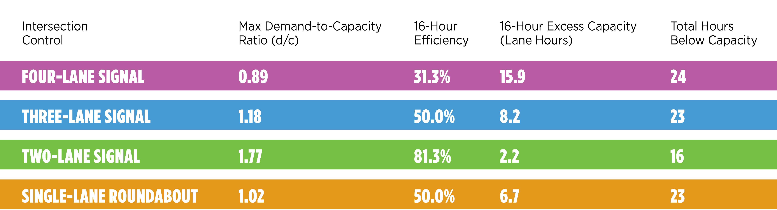
Notes:
And we look at metrics for the 24-hour capacity framework…
When making design decisions strictly based on the design hourly volume (represented by the maximum d/c ratio column), the four-lane signal alternative is the only viable option, with all remaining alternatives exceeding capacity for at least one of the hours.
However, expanding the analysis framework to include the 16-hour efficiency measure, the same four-lane signal alternative is only 31.3% efficient. It shows nearly 16 lane hours of excess capacity; almost an entire lane is completely empty for 16 hours of the day, even after excluding nighttime hours.
Comparatively, the three-lane signal and roundabout options increase efficiency to 50% (with only about 7-9 hours of excess capacity).
Finally, the total hours below capacity per day show that while the four-lane signal is below capacity 24 hours of the day, the three-lane signal and roundabout alternatives still show 23 hours below capacity. This also means that the three-lane signal and roundabout alternatives are only exceeding capacity one hour of the day.

Slide 25


“Just to be Safe” …
… we design for the peak 15-minutes of the day …
… we estimate traffic for the 30th highest hour of the year …
… we forecast traffic out 20 years from the current year …
… we use an average measure of capacity …
… we design our intersection to be below that capacity …
… we target a LOS grade of D …
… we add a safety margin to our intersection timing (X_{c}) …
…

Slide 26
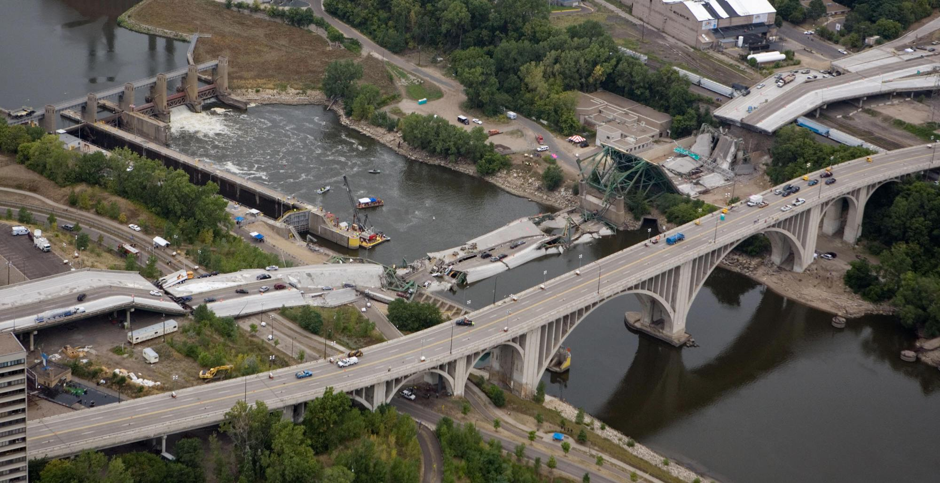
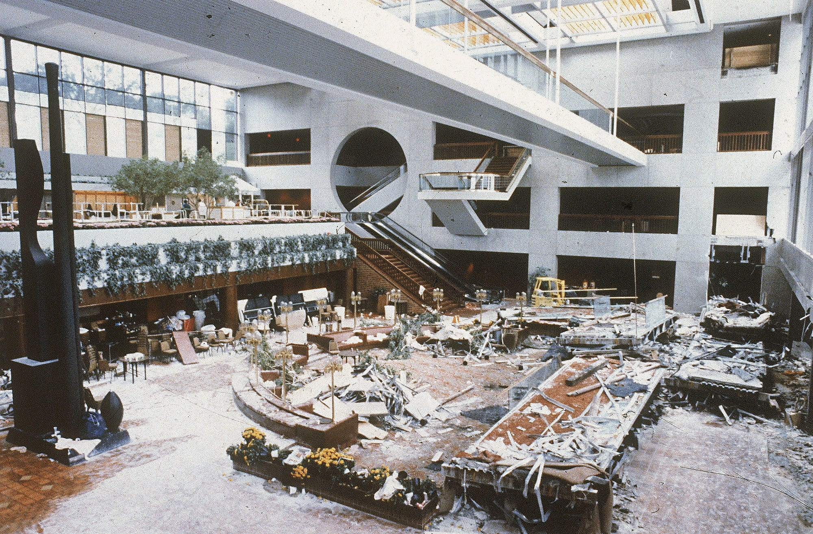

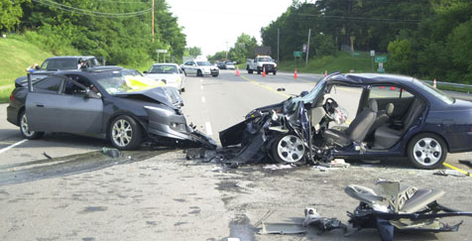
What is Failure?

Slide 27
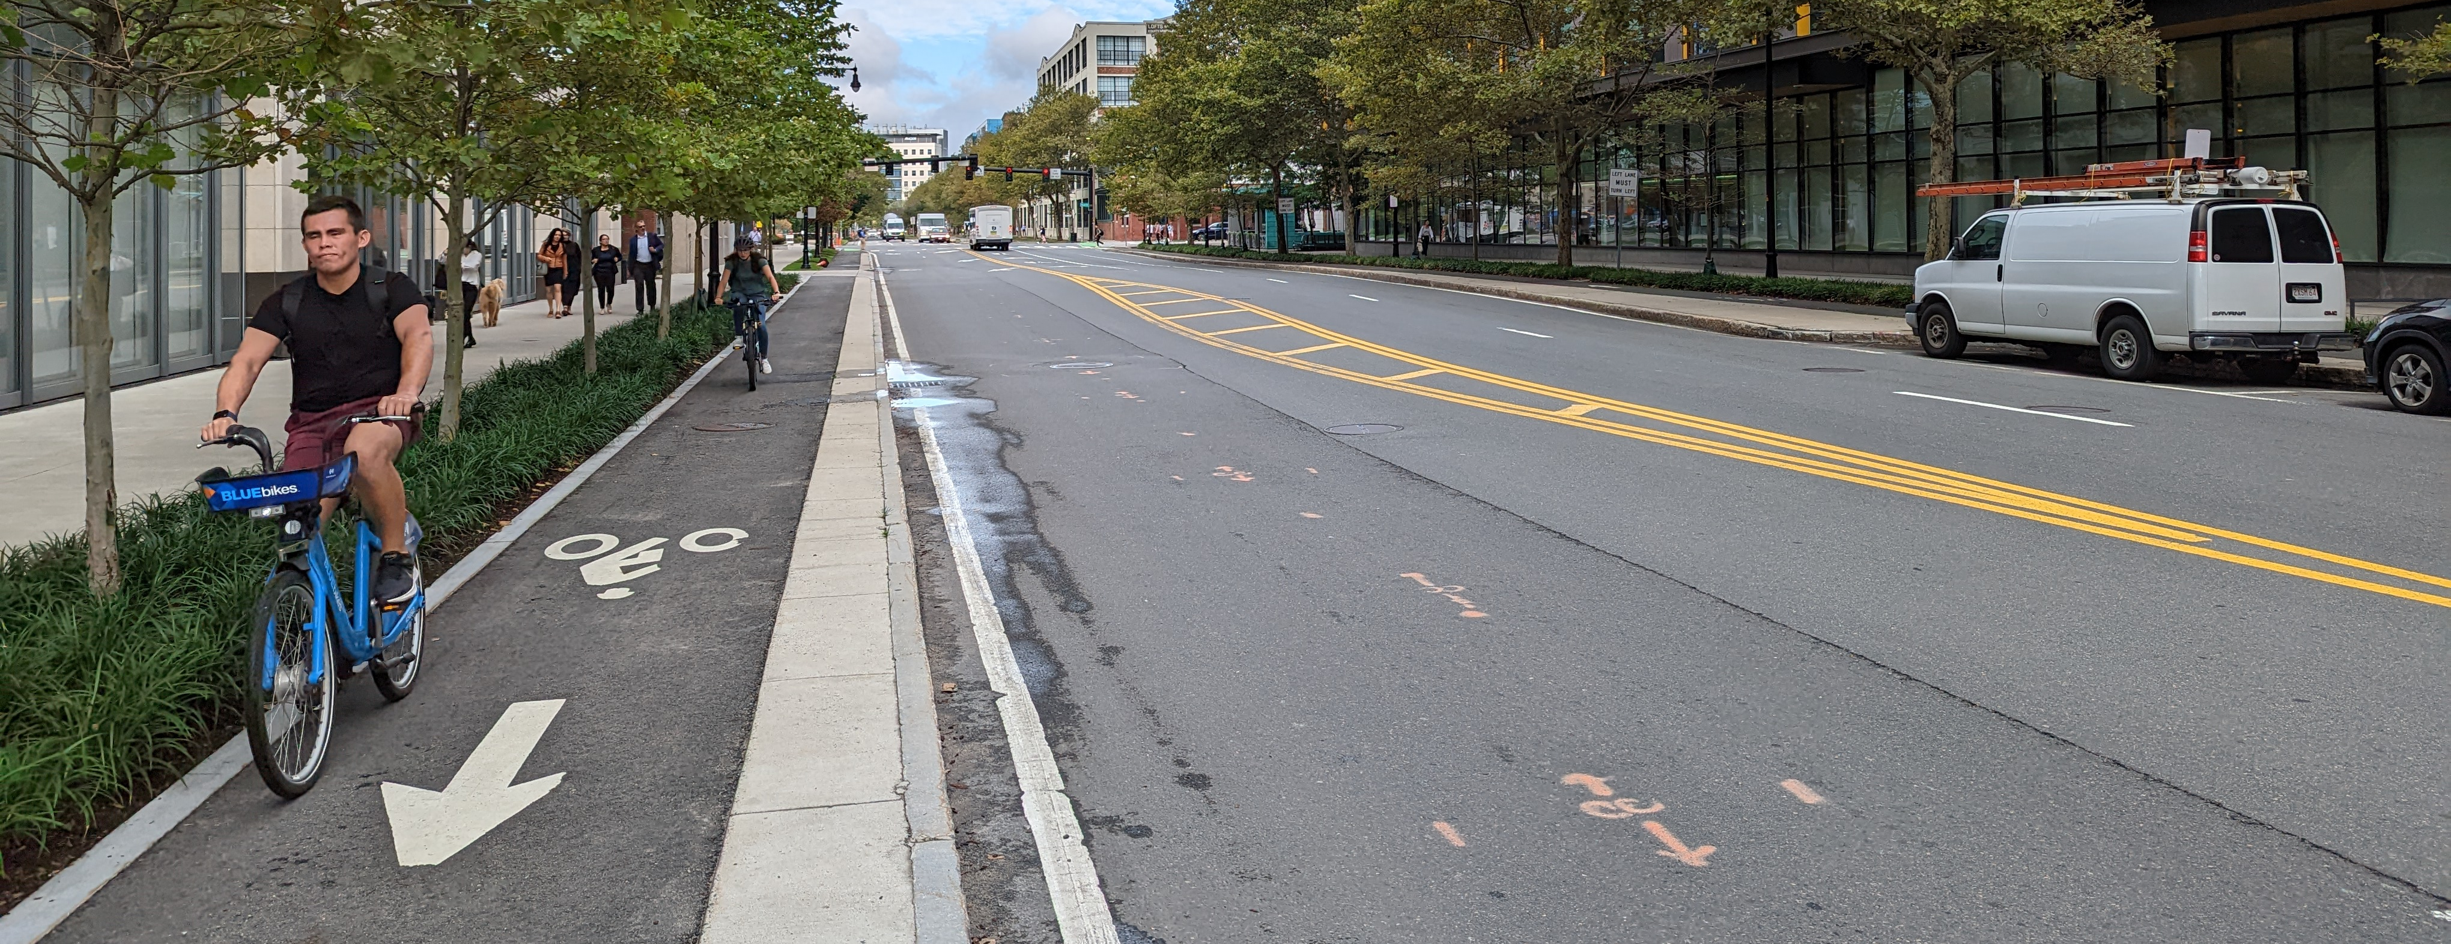
RAISE THE FLOOR ON TRANSPORTATION SAFETY
Notes:
What do we mean when we say – raise the floor?

Slide 28

d = 51 sec
d = 54 sec
Predictions of fatal and injury crashes over 20-year intersection service life based on AASHTO Highway Safety Manual, calculated in FHWA SPICE Tool
Roundabout
F
D

Slide 29
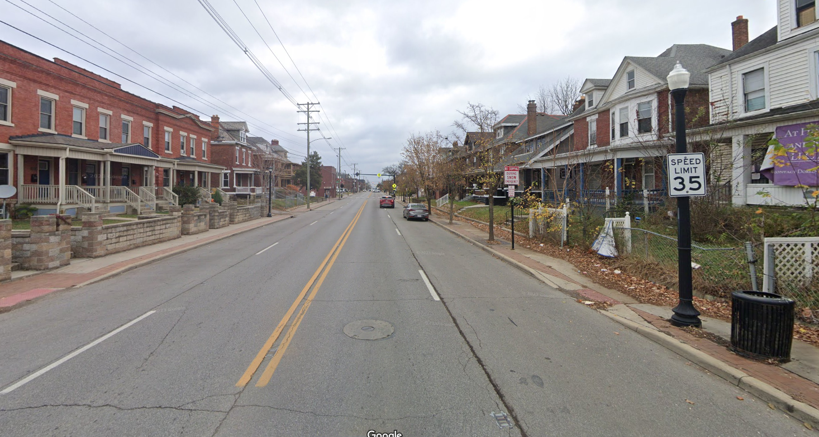
An Actual Example

Slide 30


ALTERNATIVES ANALYSIS
Option 1: Three-Lane Cross-Section with Two-Way Left Turn Lanes
Option 2: Two-Lane Cross-Section with Median

Slide 31
Notes:
Non-linear – stepwise fashion
Pay attention to the negative space
This case study emphasizes the order of magnitude impact of designing to peak hour capacity

Slide 32
How do we Change our Approach?
Stop Relying solely on (LOS)
→ Instead use the actual performance measures in the HCM (which are what we measured and researched!)
Look Beyond the Peak Hour
→ We have the methods and the data to analyze 24-hour performance (hint: we already do this for work zones!)
Use Safety Performance Measures
→ We have the HSM (soon HSM2) and the means to predict safety outcomes, let’s use them.

Slide 33

Questions
Bastian Schroeder
Kittelson and Associates
bschroeder@kittelson.com

